Slide 1
Introduction to Survival Analysis
Xiaolan Liao, Ph.D.
Yutian Thompson, Ph.D.
April 29th, 2022
Department of Pediatrics
University of Oklahoma Health Sciences Center
Notes:
Welcome
Today, me and Yutian will discuss Survival analysis which is frequently used in medical studies

Slide 2
Outline
Survival Analysis
Time to event
Censored data
Survival function and Hazard function
Kaplan-Meier method
Kaplan-Meier estimates & curves
Cox Proportional Hazard model
Cox Proportional Hazard model estimates
Model Evaluation
An example data to show how the process work
Application to real data with implementation in R
Notes:
Special characteristics of survival analysis, and two popular survival analysis methods, use an example data to walk through the process and followed by an application using one of our own data, with implementation in R

Slide 3
Learning Objectives
After this presentation, participants should be able to
Recognize or describe the type of problems addressed by survival analysis
Understand Censoring
Understand Survival and Hazard Functions
Understand Models and Hypothesis Testing
Kaplan-Meier survival curve & estimates
Log-rank test
Cox Proportional Hazards Model
Notes:
After this presentation, you should be able to …

Slide 4
What is Survival Analysis?
Survival analysis, refers to a set of statistical procedures for data analysis for which the outcome variable of interest is time until an event occurs
Examples:
A study that follows leukemia patients in remission over several weeks to see how long they stay in remission
Time: weeks until a person goes out of remission
Event of interest: going out of remission
A study that follows a disease-free cohort of individuals over several years to see who develops heart disease
Time: years until a person develops heart disease
Event of interest: developing heart disease
A 13-year follow-up of an elderly population(60+ years) to see how long subjects remain alive.
Time: years until death
Event: death
Notes:
So, what is survival analysis?
Survival analysis is a collection of statistical methods that study time to event data;
Let’s look at a few examples before I explain what is time to event data:
Examples:
In each of the studies, there us a time variable, and event of interest
A study that follows leukemia patients in remission over several weeks to see how long they stay in remission
Time: time in weeks until a person goes out of remission
Event of interest(i.e., failure): going out of remission
A study that follows a disease-free cohort of individuals over several years to see who develops heart disease
Time: time in years until a person develops heart disease
Event of interest: developing heart disease
A 13-year follow-up of an elderly population(60+ years) to see how long subjects remain alive.
Time: time in years until death
Event: death

Slide 5
What is Survival Analysis?
Survival analysis used in non-medical disciplines
Reliability theory or Reliability analysis in engineering
E.g., time until the battery becomes defective
Duration analysis or Duration modeling in economics
E.g., time until re-employment
Event history analysis in sociology
E.g., time until a member retires from Congress
Notes:
Survival analysis are also used in non-medical fields, but they are using different names, for example, in engineering, they use the term Reliability theory, they study the lifetime of a battery

Slide 6

Time to Event Data
Longitudinal data that measures Time until an Event of interest occurs
Key components to Time-to-Event Data:
The time origin precisely specified for all individuals (e.g., the onset of exposure or diagnosis)
The event occurrence needs to be clearly defined (e.g., death, disease, relapse, recovery)
The measurement scale for time must be selected (e.g., years, months, weeks, days; age)
Notes:
What’s special about time to event
It’s longitudinal data
It has three key components
It has time origin, it’s the start follow-up time, depends on the specific study, it could be a diagnosis of disease, the date of surgery, the date discharged from hospital, the day was born
It has an event of interest,
It has the time measurement, depends on the study, it could be in days, months, weeks, years,; or age)

Slide 7
What Makes Survival Data Special? Censoring
Censoring is a condition in which the value of a measurement or observation is only partially known
Censoring can happen
(1) does not experience the event before the study ends
(2) lost to follow-up
(3) withdraws from the study
There is no knowledge of what happened thereafter
Notes:
For example:
In a cohort, not every patient being followed will die during the follow-up period,
the study ends before the subject had the event of interest occur, i.e., They survived at least until the end of the study,
Censoring can occur within the study or terminally at the end.

Slide 8
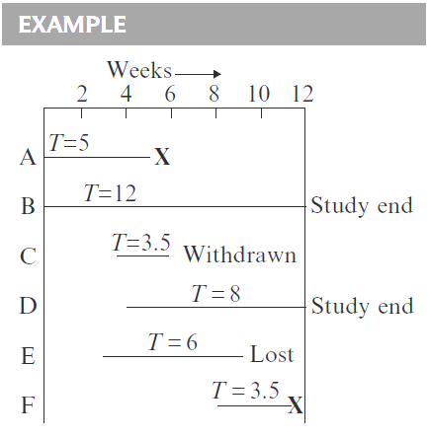

Censoring (Right-Censoring)
Person A:
followed from the start of the study until getting the event at week 5
his survival time is 5 weeks and survival time is not censored.
Person B: 12-week, censored
Person C: 3.5-week, censored
Person D: 8-week, censored
Person E: 6-week, censored
Person F: 3.5-week, not censored
Notes:
Let’s look at an example of six patients ;
Look at person C & F
We only cover right-censoring data; Yes, there is also left-censoring; which means we don’t have information before the events happened. To not confuse you, we focus on right-censored data today, right-censored data is more common type of censoring

Slide 9
Questions of Interest in Survival Analysis
The questions of interest in survival analysis:
What is the chance that a patient (e.g., cancer) survives 5 years?
Are there differences in survival probability between treatment groups?
How do certain personal, behavioral, or clinical characteristics affect participants' chances of survival?
E.g., weight, chronic conditions, diet quality, BMI
Notes:
With the survival data; we are typically interested in getting answers to the following types of questions
What’s the chance that I can survive 5 years after I was diagnosed with cancer?
Will it make a difference in my survival probability if I receive treatment?
Do other factors such as my weight, BM, and other chronic conditions play a role in my survival chance?

Slide 10

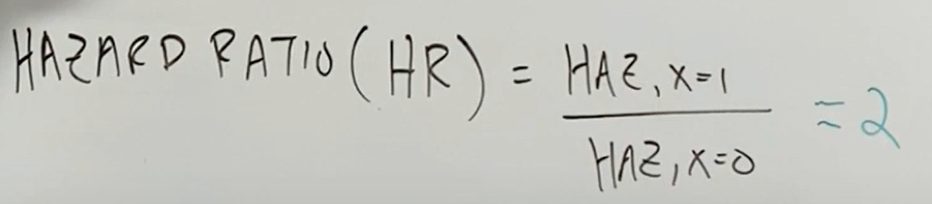
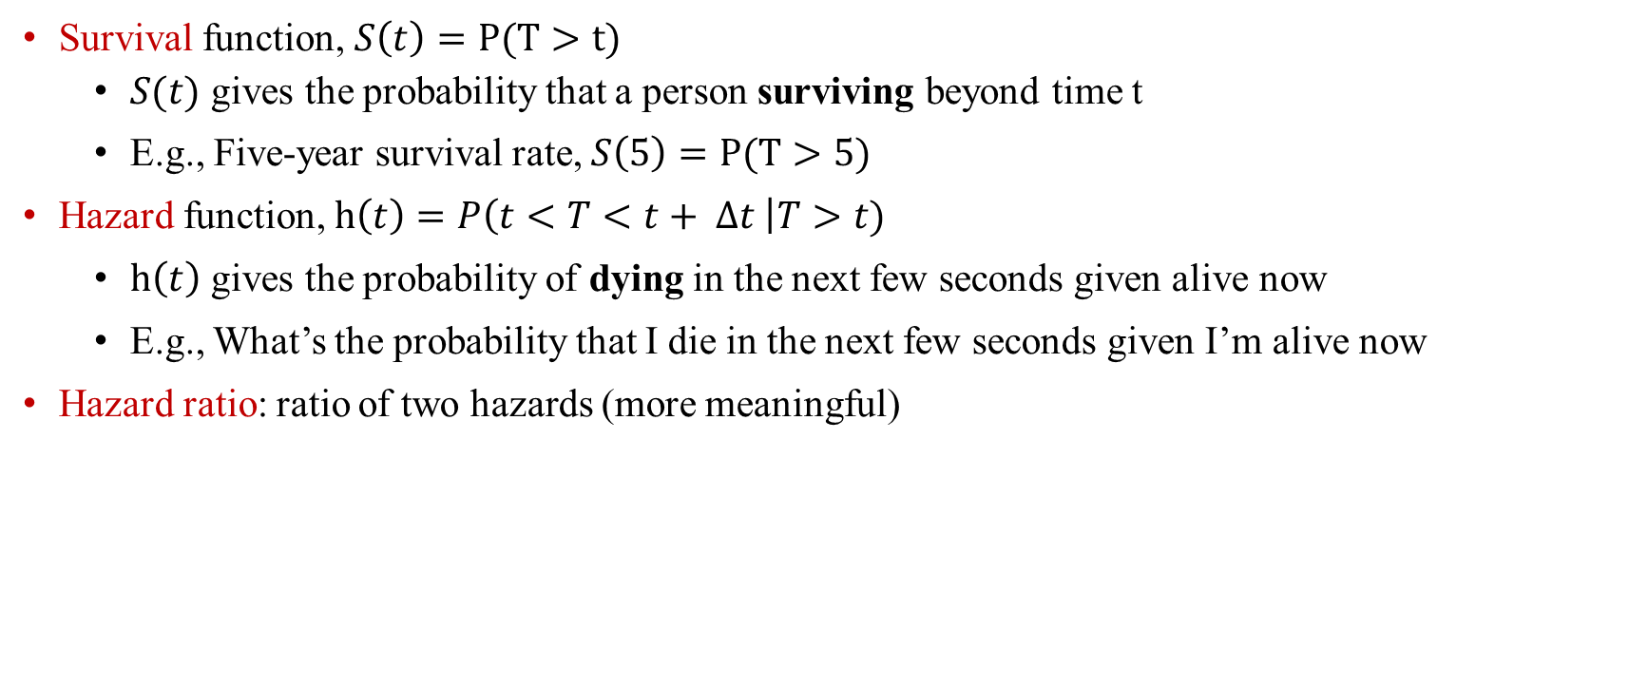
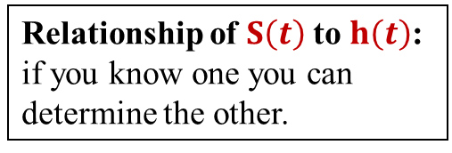
Key Terminology
Survival function, $S\left(t\right)=P(T>t)$
$S(t)$ gives the probability that a person surviving beyond time t
E.g., Five-year survival rate, $S\left(5\right)=P(T>5)$
Hazard function, $h\left(t\right)=P\left(t<T<t+ ∆t \right|T>t)$
$h\left(t\right)$ gives the probability of dying in the next few seconds given alive now
E.g., What’s the probability that I die in the next few seconds given I’m alive now
Hazard ratio: ratio of two hazards (more meaningful)
Relationship of $S\left(t\right)$to $h\left(t\right)$: if you know one you can determine the other.
Interpretation:
At a given instance of time, someone who’s exposed to the risk factor, their risk of dying is double someone who’s not exposed
Notes:
To address those questions; a few functions were developed by mathematicians and statisticians:
Survival function
Hazard function
Hazard ratio
Survivor function: The survival function is a function that gives the probability that a patient, interest will survive past a certain time.
The instantaneous hazard rate is the limit of the number of events per unit of time divided by the number at risk, as the time interval approaches 0.

Slide 11
Goals of Survival Analysis
Basic goals of survival analysis
To estimate and interpret survivor and/or hazard functions from survival data
To compare survivor and/or hazard functions across treatment groups
To assess the relationship of explanatory variables to survival time
Notes:
With the questions in mind, and terms defined;
Now the Goals of survival analysis, become clear: and concrete: what we can get from survival analysis

Slide 12
Models for Analyzing Censored Data
Nonparametric: Kaplan-Meier estimator
Simple to interpret
Survival curve can be created based on K-M estimator
Can not directly estimate the Hazard ratio
Semi-parametric: The Cox Proportional Hazards Model
Most popular; robust
Estimate Hazard ratio; evaluate the effect size
Does not provide the predicted value of hazard
Parametric: e.g., Weibull, Exponential
Assumes survival time follows a known distribution
Less realistic
Machine learning: Random Survival Forest (RSF)
Notes:
To achieve these goals, a set of methods are developed, and more are being developed to address limitations with the existing methods
Popular models for analyzing survival data
Focus on Kaplan-Meier & Cox regression model

Slide 13
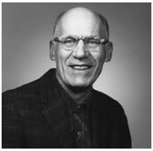
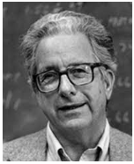
Edward L. Kaplan and Paul Meier
In 1958, Edward L. Kaplan and Paul Meier collaborated to publish a seminal paper addressing the censoring (e.g., incomplete observations) issue
Now, K-M is a standard way to report patient survival in medical and epidemiological studies
Before the K-M method:
5-year survival rate: bias
Edward L. Kaplan
Paul Meier
Notes:
‘
Paul Meier was half of the collaboration that created the algorithm, first published in 1958 as “Nonparametric estimation from incomplete observations” in the Journal of the American Statistical Association (1958;53:457-81, doi:10.2307/2281868).
His partnership with Edward L Kaplan was essentially a shotgun marriage arranged by an editor who did not want to publish two similar but somewhat conflicting papers. He told the pair to work it out and produce a single paper. It took four years of further refinements before the collaborative document was ready.

Slide 14
Ignore Censoring: Bias
If censored patients were assumed to remain alive until the end of the study
$$survival rate =\frac{No.of alive+No. of censored}{Total} \text{(}\text{Over}\text{estimate}\text{)}$$
If censored patients were removed from the cohort
$survival rate =\frac{No.of alive + No. of censored}{Total}$ (Underestimate)
$$Total= No.of alive at end +No.of died+No. of censored$$
Notes:
Specifically, they either will Overestimate and underestimate survival rate or underestimate, depends on whether they assume the censored patients remain alive or dead; both are problematic

Slide 15
Kaplan–Meier Method
K-M method is relatively simple; KM survival curves can be computed using one of many statistical software packages (E.g.: SAS, SPSS, or R)
Three pieces of information for each patient:
The first date of follow-up
The last date of follow-up
The status on that last date
The study group they are in (optional)

Slide 16
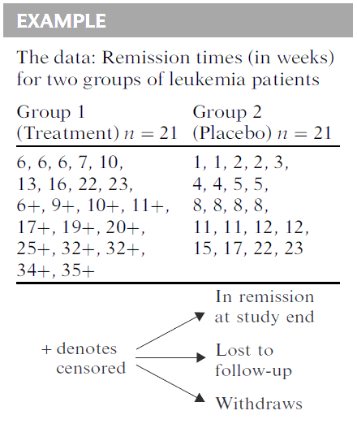
Example: Remission Data
Data:
21 patients in each group
Group1:
9 failed and 12 were censored
Group2:
none are censored, all 21 persons went out of remission during the study period
Notes:
Let’s use an example to show how to generate K-M estimate
The data for this example derive from a study of the remission times in weeks for two groups of leukemia patients, with 21 patients in each group.
Group 1 is the treatment group and
group 2 is the placebo group.
The basic question of interest concerns comparing the survival experience of the two groups

Slide 17
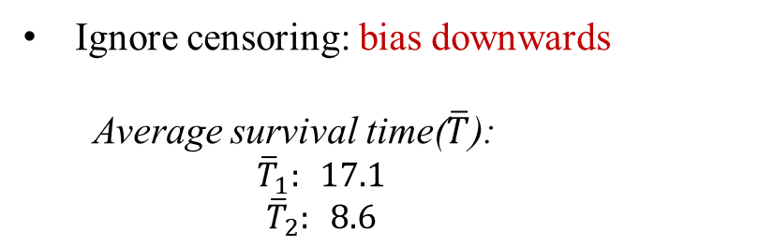
Example: Remission Data
Descriptive Measures:
Ignore censoring: bias downwards
Average survival time($\overline{T}$):
$${\overline{T}}_{1}: 17.1$$
$${\overline{T}}_{2}: 8.6$$
Can use median instead
Does not give a comparison over time
Notes:
The data for this example derive from a study of the remission times in weeks for two groups of leukemia patients, with 21 patients in each group.
Group 1 is the treatment group and
group 2 is the placebo group.
The basic question of interest concerns comparing the survival experience of the two groups
How long I can stay in remission after the treatment? A statistical natural way to answer the question is to use a measure of central tendency, for example, mean, if we use mean, we are ignoring censoring here, meaning that we assume the censored patient had the event by the time of censoring, bias results.
Also the descriptive measure only gives us overall information, and does not tell us information over time.
Alternative method must be sought,

Slide 18
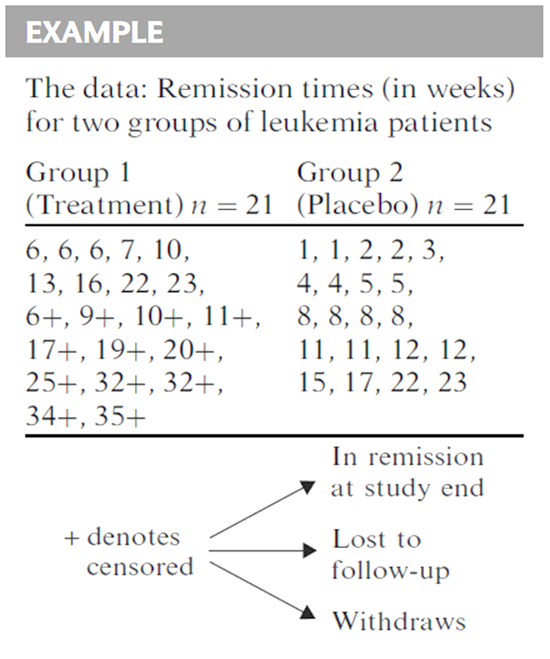
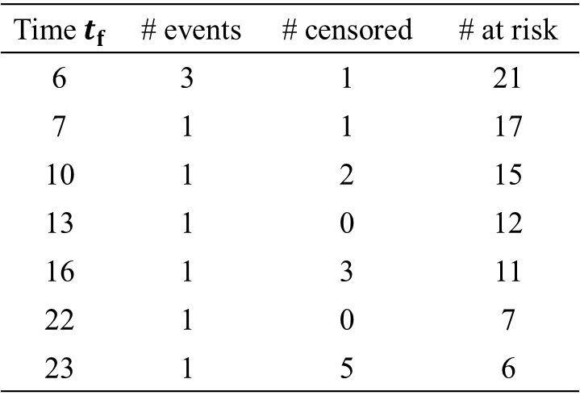
Example: Remission
Group 1 using ordered failure times
Time $t_{f}$ | # events | # censored | # at risk
6 | 3 | 1 | 21
7 | 1 | 1 | 17
10 | 1 | 2 | 15
13 | 1 | 0 | 12
16 | 1 | 3 | 11
22 | 1 | 0 | 7
23 | 1 | 5 | 6
17 persons survive >=7 weeks
Notes:
so instead, we use the K-M method based on a life table
In order to do that, we need to put the original data into an ordered life table, ordered by failure times, in the table, we also have information on the number of events within each duration, number of censored within each duration
Let’s look at the first row, the failure time is 6,

Slide 19
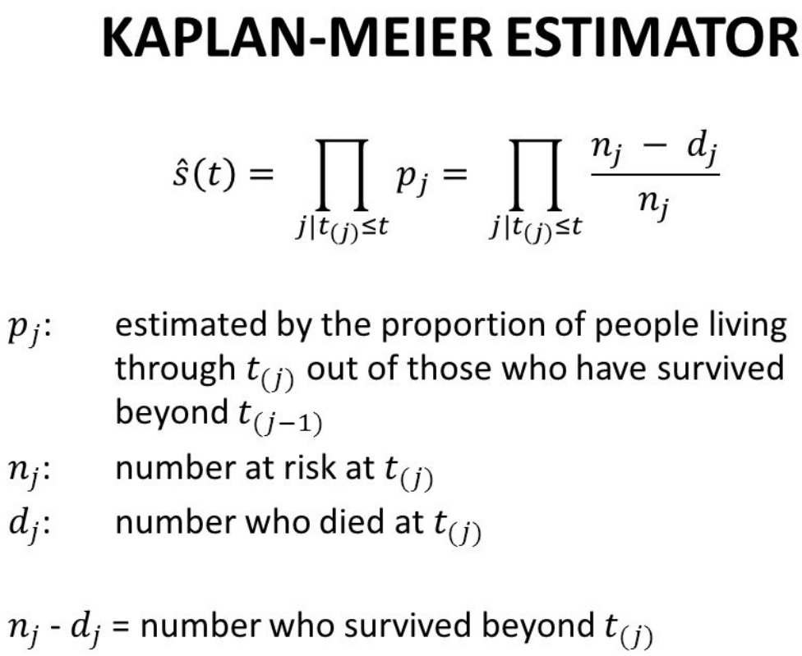
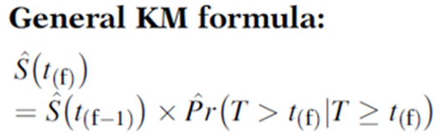
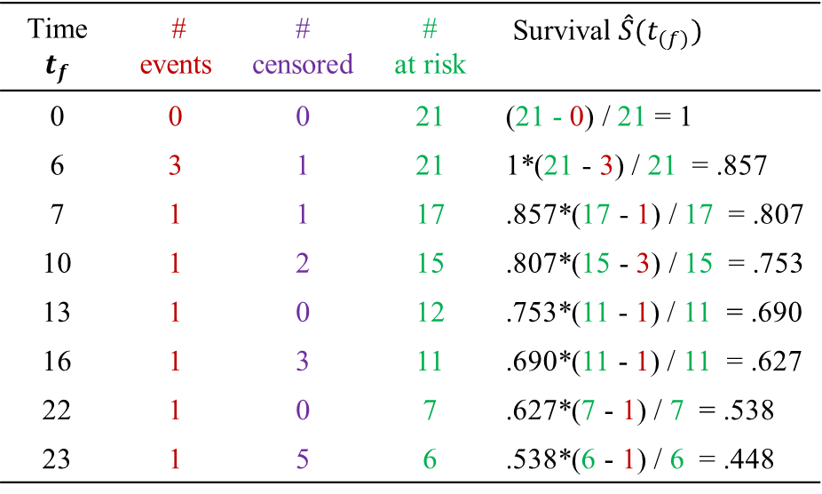
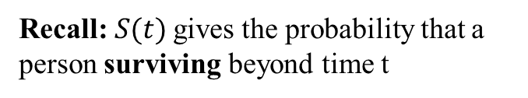
Example: Remission
Group 1 (Treatment):
Recall:$S(t)$ gives the probability that a person surviving beyond time t
Time $t_{f}$ | # events | # censored | # at risk | Surviva$l \hat{S}(t_{(f)})$
0 | 0 | 0 | 21 | (21 - 0) / 21 = 1
6 | 3 | 1 | 21 | 1*(21 - 3) / 21 = .857
7 | 1 | 1 | 17 | .857*(17 - 1) / 17 = .807
10 | 1 | 2 | 15 | .807*(15 - 3) / 15 = .753
13 | 1 | 0 | 12 | .753*(11 - 1) / 11 = .690
16 | 1 | 3 | 11 | .690*(11 - 1) / 11 = .627
22 | 1 | 0 | 7 | .627*(7 - 1) / 7 = .538
23 | 1 | 5 | 6 | .538*(6 - 1) / 6 = .448
Notes:
With the life table, we now able to compute the survival probability

Slide 20
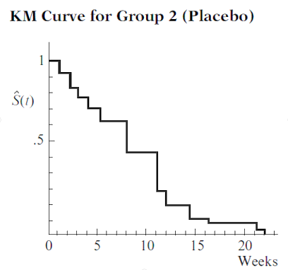

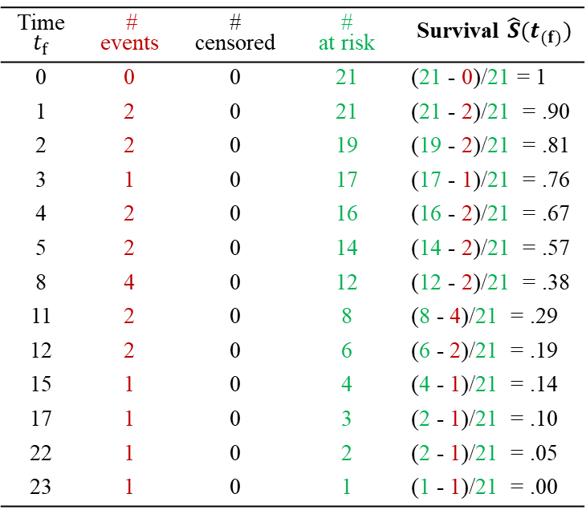
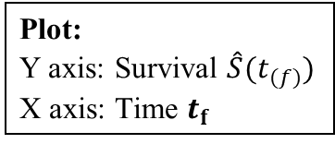
Example: Remission
Group 2 (Placebo):
Time $t_{f}$ | # events | # censored | # at risk | Survival $\hat{S}(t_{(f)})$
0 | 0 | 0 | 21 | (21 - 0)/21 = 1
1 | 2 | 0 | 21 | (21 - 2)/21 = .90
2 | 2 | 0 | 19 | (19 - 2)/21 = .81
3 | 1 | 0 | 17 | (17 - 1)/21 = .76
4 | 2 | 0 | 16 | (16 - 2)/21 = .67
5 | 2 | 0 | 14 | (14 - 2)/21 = .57
8 | 4 | 0 | 12 | (12 - 2)/21 = .38
11 | 2 | 0 | 8 | (8 - 4)/21 = .29
12 | 2 | 0 | 6 | (6 - 2)/21 = .19
15 | 1 | 0 | 4 | (4 - 1)/21 = .14
17 | 1 | 0 | 3 | (2 - 1)/21 = .10
22 | 1 | 0 | 2 | (2 - 1)/21 = .05
23 | 1 | 0 | 1 | (1 - 1)/21 = .00
Plot:
Y axis: Survival $\hat{S}(t_{(f)})$
X axis: Time $t_{f}$
Notes:
Look at group2, which has no censorship in the data, the survivor is very easy to compute;
Survivor probability is computed as the number of survivors divided by the total number of patients in the beginning

Slide 21
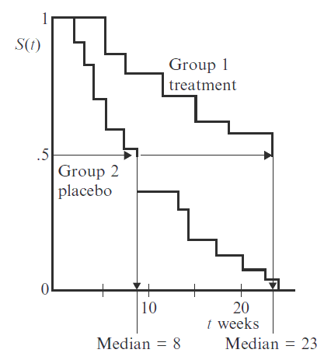
Example: Remission
Interpretation:
group 1 is consistently higher > group 2
group 1 has a better survival prognosis > group 2
moreover, as the number of weeks increases, the two curves appear to get farther apart, suggesting that the beneficial effects of the treatment over the placebo are greater the longer one stays in remission
Median survival time:
the time at which the survival probability is .5
Median (treatment) = 23 weeks
Median (placebo) = 8 weeks
Notes:
We’re more interested in comparing the curves; so, plot the curves in one graph. What does the graph tell us?

Slide 22

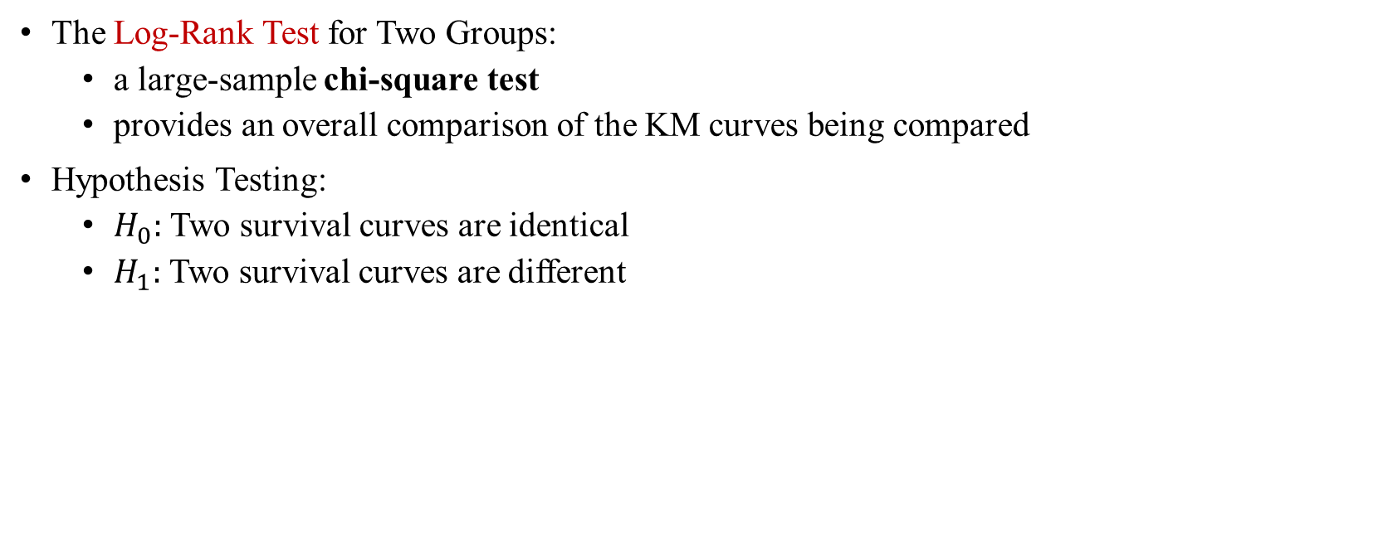
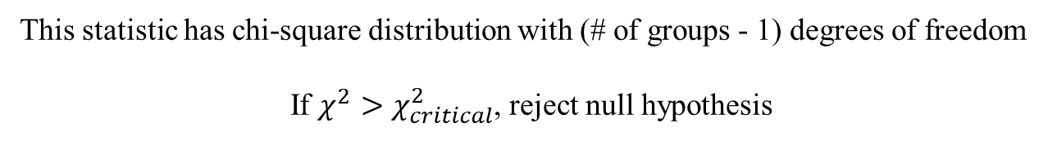
Are KM Curves Statistically Different?
The Log-Rank Test for Two Groups:
a large-sample chi-square test
provides an overall comparison of the KM curves being compared
Hypothesis Testing:
$H_{0}:$ Two survival curves are identical
$H_{1}:$ Two survival curves are different
This statistic has chi-square distribution with (# of groups - 1) degrees of freedom
If $χ^{2}>χ_{critical}^{2}$, reject null hypothesis
Notes:
After seeing the graph, we would want to know whether the curves are significantly different?
Basic idea of log-rank Test; to test whether two distributions are different; many variations to the computation formula; good news software will output the Log rank test for you

Slide 23
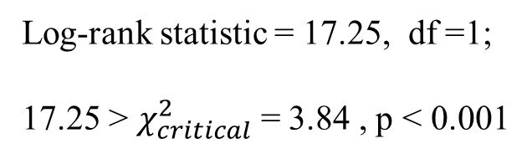
Log-Rank Test
This P-value indicates that the null hypothesis should be rejected
We can therefore conclude that the treatment and placebo groups have significantly different KM survival curves
Log-rank statistic = 17.25, df =1;
17.25 > $χ_{critical}^{2}$ = 3.84 , p < 0.001
Notes:
Here is the log-rank statistic for the two curves

Slide 24
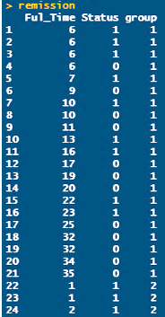
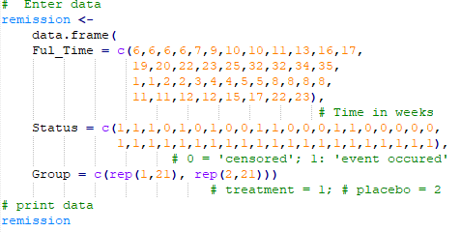
R Implementation of Example Data
R code:
Output:

Slide 25
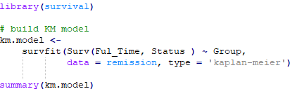
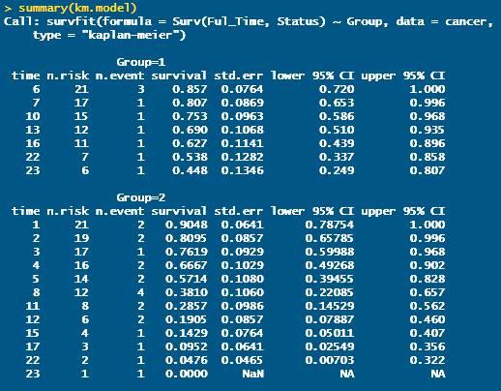
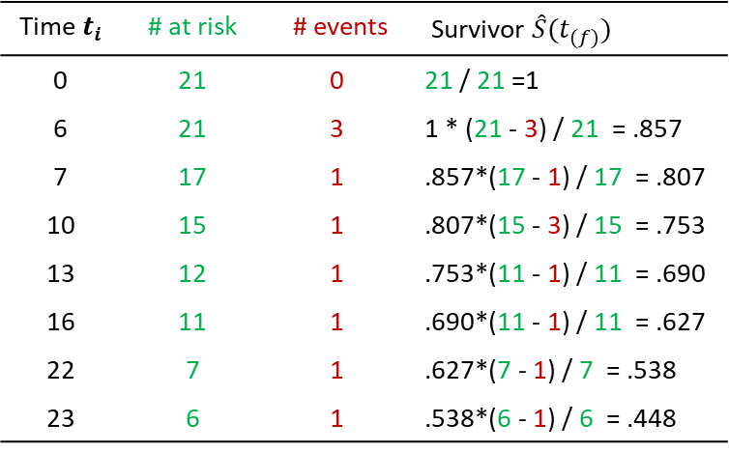
R Implementation
R code:
Output:
Time $t_{i}$ | # at risk | # events | Survivor $\hat{S}(t_{(f)})$
0 | 21 | 0 | 21 / 21 =1
6 | 21 | 3 | 1 * (21 - 3) / 21 = .857
7 | 17 | 1 | .857*(17 - 1) / 17 = .807
10 | 15 | 1 | .807*(15 - 3) / 15 = .753
13 | 12 | 1 | .753*(11 - 1) / 11 = .690
16 | 11 | 1 | .690*(11 - 1) / 11 = .627
22 | 7 | 1 | .627*(7 - 1) / 7 = .538
23 | 6 | 1 | .538*(6 - 1) / 6 = .448

Slide 26
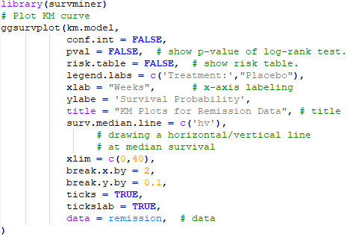
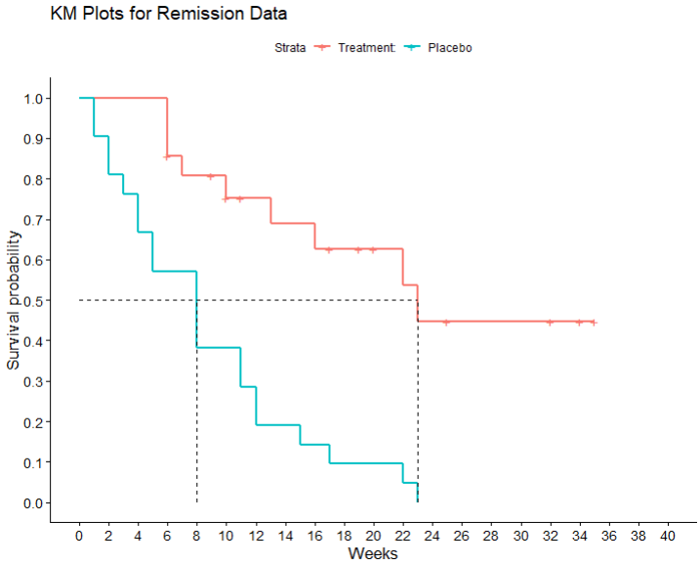
R Implementation
R code:
Output:
Median Survival

Slide 27
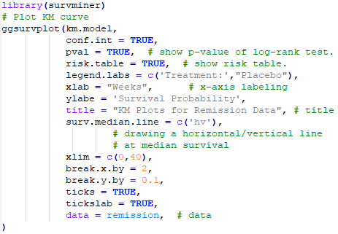
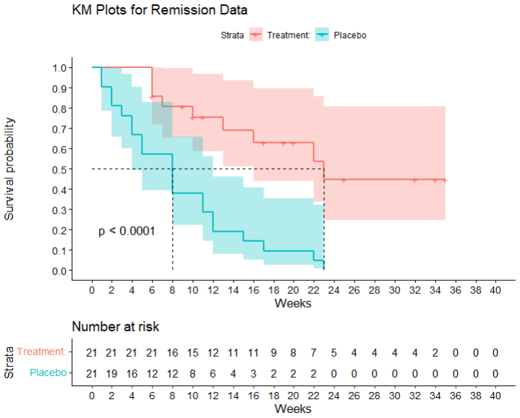
R Implementation
R code:
Output:
Notes:
Risk table; gives the information on number of patients in the risk set

Slide 28



Recall: Goals of Survival Analysis
Basic goals of survival analysis
To estimate and interpret survivor and/or hazard functions from survival data
To compare survivor and/or hazard functions across treatment groups
To assess the relationship of explanatory variables to survival time
$$√$$
$$√$$
$$?$$
Notes:
With the questions in mind, and concepts defined;
Now the Goals of survival analysis, become clear: and concrete: what we can get from survival analysis

Slide 29
Limitation of Kaplan-Meier Estimates
What happens when you have several covariates that you believe contribute to survival?
Example: Smoking, age, gender
Can use stratified K-M curves – for 2 or maybe 3 covariates
Need another approach – multivariate Cox proportional hazards model is most common for many covariates

Slide 30
Cox Proportional Hazards Model
Cox proportional hazards model (aka, Cox Regression Model, 1972)
Semi-parametric model
Directly specify a form for the hazard function
Conveniently separates baseline hazard function from covariates
Baseline hazard function over time
Covariates are time-independent
$$h\left(t,X\right)=h_{0}\left(t\right) × e^{β_{1}x_{1}+β_{2}x_{2}+ … +β_{p}x_{p}}$$
Baseline hazard involves t but not X’s
Exponential involves X’s but not t;
X’s are time- independent
Notes:
The shape of the baseline hazard function is irrelevant
The precise times are irrelevant: only their rank order matters
It plays a trick here; it can evaluate the hazards ratio with estimate the baseline hazard; and surprising, that even does not affect the accuracy of the estimate; smart tricks – that’s the beauty of math – magic!

Slide 31

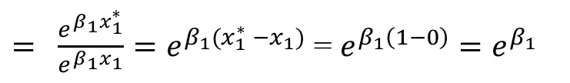
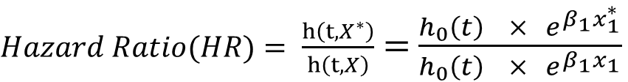
Cox Proportional Hazards Model
Measure of effect: hazard ratio (HR) involves only $β$’s, without estimating $h_{0}\left(t\right)$
$Hazard Ratio(HR)= \frac{h\left(t,X^{∗}\right)}{h\left(t,X\right)}$ $=$ $\frac{h_{0}\left(t\right) × e^{β_{1}x_{1}^{∗}}}{h_{0}\left(t\right) × e^{β_{1}x_{1}}}$
$= \frac{e^{β_{1}x_{1}^{∗}}}{e^{β_{1}x_{1}}}=e^{β_{1}(x_{1}^{∗} −x_{1})}$ = $e^{β_{1}\left(1−0\right)}=e^{β_{1}}$
$$X^{∗}=\left(x_{1}^{∗} \right), where{ x}_{1}^{∗}=1 denotes placebo group$$
$$X=\left(x_{1} \right), where x_{1}=0 denotes treatment group$$
Notes:
The cox PH model,
What the hazard ratio tell us? The Hr

Slide 32
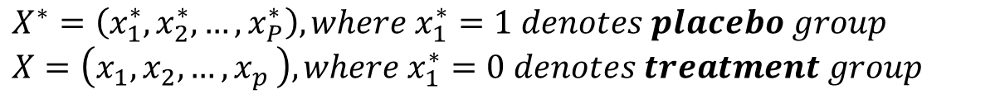
Cox Proportional Hazards Model
Measure of effect adjusted for covariates
$$Hazard Ratio\left(HR\right)=\frac{h\left(t,X^{∗}\right)}{h\left(t,X\right)} =\frac{h_{0}\left(t\right) × e^{β_{1}x_{1}^{∗}+β_{2}x_{2}^{∗}+ … +β_{p}x_{p}^{∗}}}{h_{0}\left(t\right) × e^{β_{1}x_{1}+β_{2}x_{2}+ … +β_{p}x_{p}}}= e^{\sum_{i=1}^{p}{{\hat{β}}_{i}}(X_{i}^{∗}−X_{i})}$$
$$X^{∗}=\left(x_{1}^{∗},x_{2}^{∗},…,x_{P}^{∗}\right), where{ x}_{1}^{∗}=1 denotes placebo group$$
$$X=\left(x_{1},x_{2},{…,x}_{p}\right), where{ x}_{1}^{∗}=0 denotes treatment group$$

Slide 33
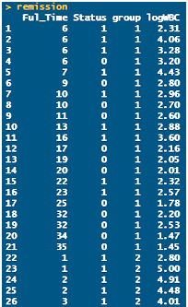
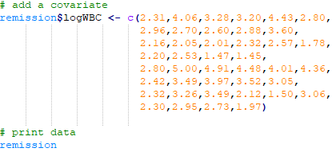
Example: Add Covariates
R code:
Output:

Slide 34
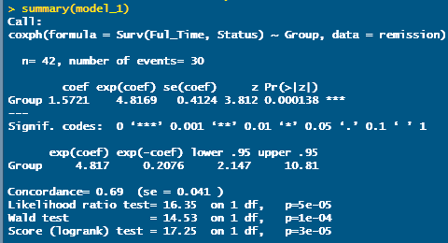
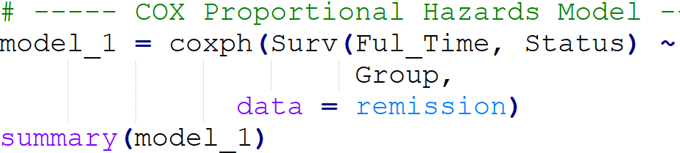
Example: Add Covariates
R code:
Output:
Model without covariate is sometimes called the “crude” model because it ignores the effect of potential covariates of interest, like log WBC.

Slide 35
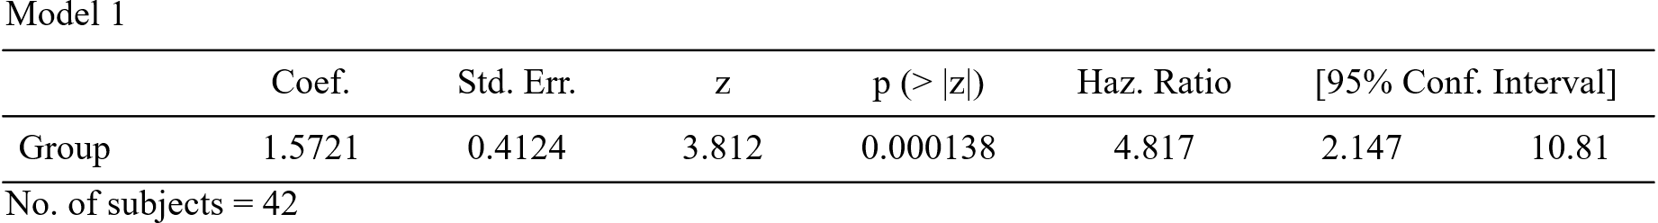

Example: Add Covariates
$e^{1.5721}$= 4.817
Hazard Ratio
Goal:
Describe the effect of treatment
Model 2:
Group: Treatment status
Results:
A point estimate of the effect of the treatment : 4.817, 95% CI = [2.147, 10.81];
This value gives the estimated hazard ratio (HR) for the effect of the treatment;
The hazard for the placebo group is ~4.8 times the hazard for the treatment group
z = 3.812, p = 0.000138

Slide 36
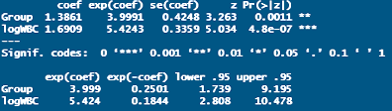
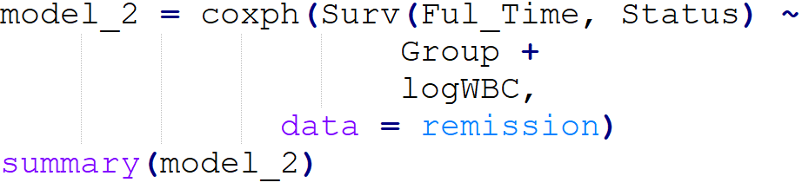
Example: Add Covariates
R code:
Output:

Slide 37
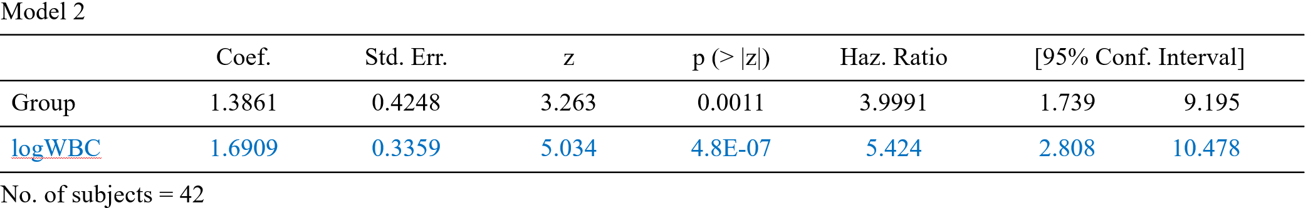
Example: Add Covariates
Goal:
Describe the effect of treatment status adjusted for log WBC.
Model 2:
logWBC: a confounder.
Results:
A point estimate of the effect of the treatment : 3.9991, 95% CI = [1.7397, 9.195];
This value gives the estimated hazard ratio (HR) for the effect of the treatment;
The hazard for the placebo group is ~4 times the hazard for the treatment group adjusted for logWBC.

Slide 38
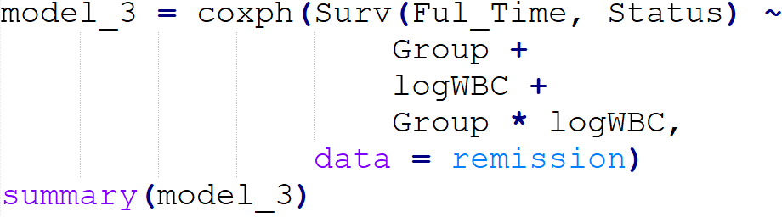
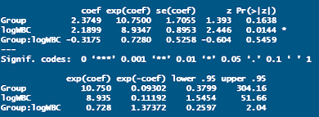
Example: Add Interaction
R code:
Output:

Slide 39
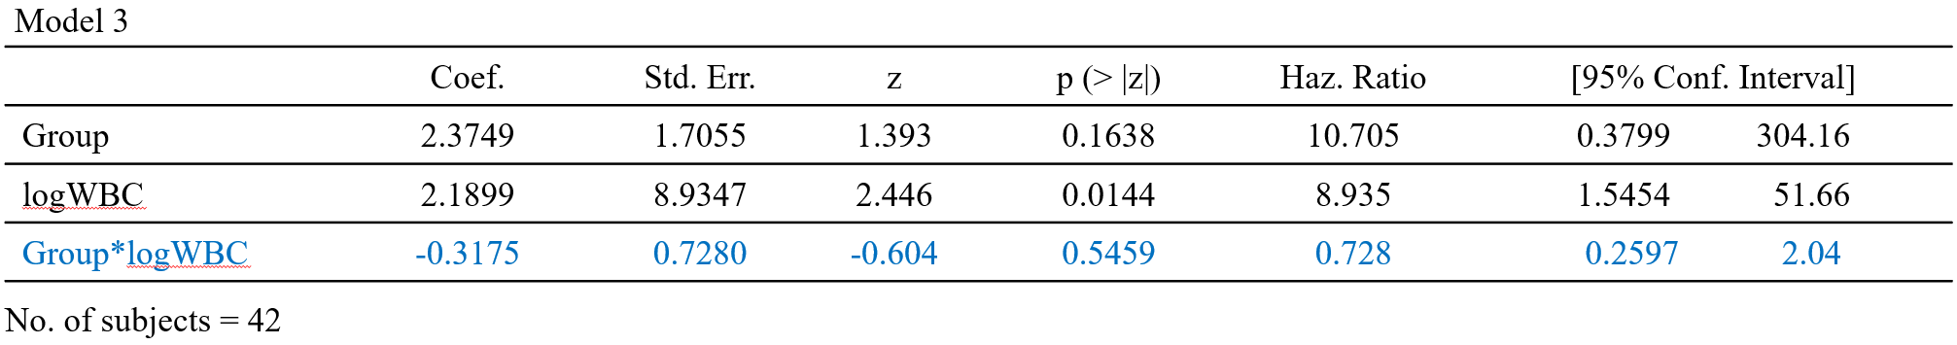
Example: Add Interaction
Goal:
Describe the interaction effect of treatment status and log WBC.
Model 3:
Group * log WBC variable: An interaction term.
Results:
A point estimate of the interaction effect : p = 0.5459 > 0.05.

Slide 40
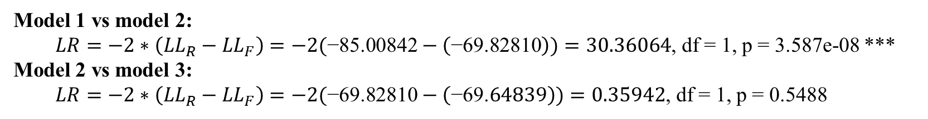
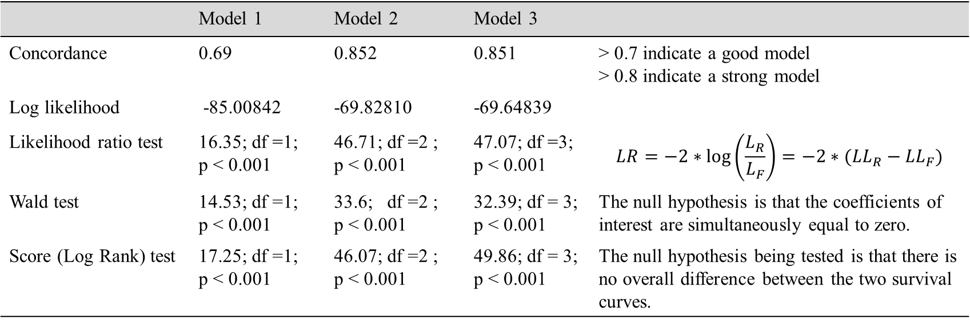
Model Comparisons
 | Model 1 | Model 2 | Model 3
Concordance | 0.69 | 0.852 | 0.851 | > 0.7 indicate a good model > 0.8 indicate a strong model
Log likelihood | -85.00842 | -69.82810 | -69.64839
Likelihood ratio test | 16.35; df =1; p < 0.001 | 46.71; df =2 ; p < 0.001 | 47.07; df =3; p < 0.001 | $$LR=−2∗\log\left(\frac{L_{R}}{L_{F}}\right)=−2∗({LL}_{R}−{LL}_{F})$$
Wald test | 14.53; df =1; p < 0.001 | 33.6; df =2 ; p < 0.001 | 32.39; df = 3; p < 0.001 | The null hypothesis is that the coefficients of interest are simultaneously equal to zero.
Score (Log Rank) test | 17.25; df =1; p < 0.001 | 46.07; df =2 ; p < 0.001 | 49.86; df = 3; p < 0.001 | The null hypothesis being tested is that there is no overall difference between the two survival curves.
Model 1 vs model 2:
$LR=−2∗\left({LL}_{R}−{LL}_{F}\right)=−2(\text{−85.00842}−\left(\text{−69.82810}\right))=30.36064$, df = 1, p = 3.587e-08 ***
Model 2 vs model 3:
$LR=−2∗\left({LL}_{R}−{LL}_{F}\right)=−2(\text{−69.}\text{82810}−\left(\text{−69.}64839\right))=0.35942$, df = 1, p = 0.5488

Slide 41
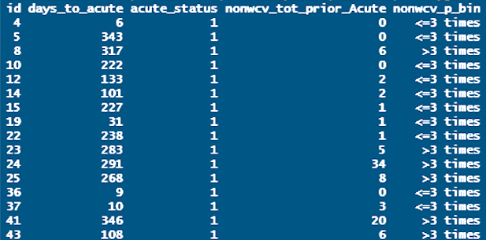
Acute Utilization
Data:
704 kids with chronical complex condition
Followed 1-year after discharged from an index ICU visit
Information on #of non-well-child-visit, time to first acute utilization
Notes:
Data

Slide 42
Our Data: Acute Utilization
Research Question:
What is the relationship between primary care use and acute care utilization?
Primary care use:
Non-well child visits
Acute care utilization:
Including ICU visits, ED visits, hospital visits
The earliest date of any visit will be used as the Time-to-Acute date.

Slide 43
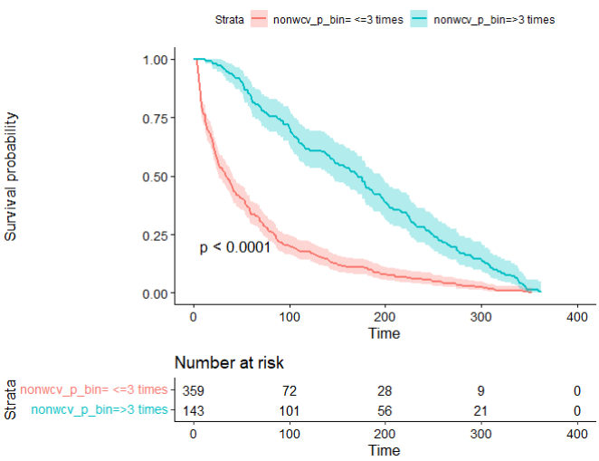
Acute Utilization: K-M Curves
KM curve for group with > 3 times nonwcv is consistently higher > group with <= 3 times
group with > 3 times , has better survival prognosis > group with <= 3 times
Moreover, before 80 days, as the number of days increases, the two curves appear to get farther apart, suggesting that the beneficial effects of group with > 3 times over group 2 are greater the longer one stays in no acute use; After 80 days, as the number of days increases, the two curves appear to get closer.

Slide 44
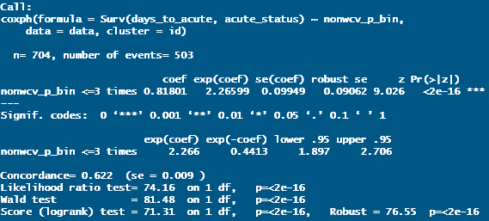
Acute Utilization: Cox PH Model
At a given instant in time, someone who has 3 times or fewer non well child visits is~ 2.3 times likely to have acute visits as someone who has more than 3 times nonwcv
CI does not include 1

Slide 45


Cox Proportional Hazards Model: Assumptions
Assumption: the HR is constant over time
Proportionality constant:
the hazard for one individual is proportional to the hazard for any other individual at any given time t.

Slide 46


Cox PH: Assumptions Check
Hypothesis test: Ho: Hazards are proportional; Ha: Hazard are not proportional
Log-log(K-M Curves): not parallel
Schoenfeld test: if allow proportion to change over time, how much it will be?
0 is not in the 95% CI band most of the time.

Slide 47
Advanced Topics
Time varying covariates
Multiple occurrences of events
More than one type of events
Discrete-time survival modeling

Slide 48
References
Cox, D. R. (1972). Regression models and life‐tables. Journal of the Royal Statistical Society: Series B (Methodological), 34(2), 187-202.
Stalpers, L. J., & Kaplan, E. L. (2018). Edward L. Kaplan and the Kaplan-Meier survival curve. BSHM Bulletin: Journal of the British Society for the History of Mathematics, 33(2), 109-135.
Kleinbaum, D. G., & Klein, M. (2012). Survival analysis: a self-learning text (Vol. 3). New York: Springer.
Goel, M. K., Khanna, P., & Kishore, J. (2010). Understanding survival analysis: Kaplan-Meier estimate. International journal of Ayurveda research, 1(4), 274.
Lee, E. T., & Wang, J. (2003). Statistical methods for survival data analysis (Vol. 476). John Wiley & Sons.

Slide 49
Q&A

